Slide 1
بِسْمِ اللهِ الرَّحْمٰنِ الرَّحِيْمِ

Slide 2

Natural Language Processing (NLP)
Lecture 01 –
Introduction to NLP
Instructor:
Dr. Jawad Shafi

Slide 3
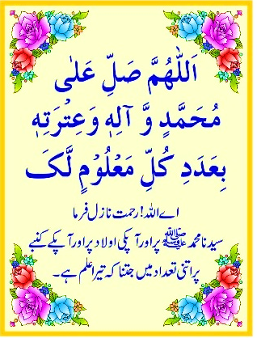
Dua – Take Help from Allah Before Starting Any Task
اللَّهُمَّ خِرْ لِيْ وَاخْتَرْ لِي
سُبْحَانَكَ لَا عِلْمَ لَنَا إِلَّا مَا عَلَّمْتَنَا ۖ
إِنَّكَ أَنْتَ الْعَلِيمُ الْحَكِيمُ
رَبِّ اشْرَحْ لِي صَدْرِي
وَيَسِّرْ لِي اَمْرِي
وَاحْلُلْ عُقْدَةً مِنْ لِسَانِي
يَفْقَهُوا قَوْلِي

Slide 4



Dr. Jawad Shafi – About Me
PhD
Lancaster University, UK
Assistant Professor
COMSATS University Islamabad, Lahore Campus
Group Member
NLP Group, CUI, Lahore Campus

Slide 5




Course Details - Instructor
Instructor
Dr. Jawad Shafi
Email
jawadshafi@cuilahore.edu.pk
Office
Room no. 182, Faculty Block
CUI Profile
https://lahore.comsats.edu.pk/Employees/551

Slide 6



Course Details – For MS/PHD Course (Cont.)
Google Classroom Code: yjms4ie
Note: Join using CUI-Lahore email ID
Office Hours: Email requests for appointment
Assessment: Not Clear

Slide 7



Course Details – Classes
Lec 01 & Lec 02
Monday
(17:30 – 20:30)
D-5 (D Block)

Slide 8
Course Focus
Mainly get Excellence in two things
Become a great Human Being
Become a great Researcher

Slide 9
Course Aims
1
To introduce essential concepts required to become a great human being and a great researcher
2
To develop skills to systematically teach any NLP concept
3
To develop skills to carry out research in NLP using a template-based approach
4
To develop internet searching skills, both general and research specific

Slide 10
Course Aims
5
To develop skills to systematically search, read and summarize a research paper / thesis
6
To develop skills to systematically make a template-based outline of a research paper / thesis and then write it
7
To develop skills to systematically design an experiment
8
To develop skills to carry out research in such a way that students who carry out research become an expert in field

Slide 11
Course Learning Outcomes (CLOs)
By the end of this course, the students should be able to
Understand what daily tasks are important to have a balanced personality
Understand how to systematically learn any concept
Understand how to search internet (both generic and research specific) to satisfy their information needs

Slide 12
Course Learning Outcomes (CLOs)
Read, write and design an experiment for a research paper / thesis using a template-based approach
Tell a coherent and connected story in a research paper / thesis
Carry out research in such a way that it enhances the self-learning abilities of students and create ability in them to cope up with the challenges of life

Slide 13
Useful Material
A Template-based Approach to Read a Research Paper
Download Link: https://ilmoirfan.com/a-template-based-approach-to-read-a-research-paper/
A Template-based Approach to Write a Research Paper
Download Link: https://ilmoirfan.com/a-template-based-approach-to-write-a-research-paper/
A Template-based Approach to Design an Experiment
Download Link: https://ilmoirfan.com/a-template-based-approach-to-design-an-experiment/

Slide 14
Useful Material Cont.
A Step-by-Step Approach to Learn Latex for Scientific Writing
Download Link: https://ilmoirfan.com/authors-page/latex/
A Template-based Approach to Write an Email
Download Link: https://ilmoirfan.com/authors-page/a-template-based-approach-to-write-an-email/

Slide 15
Instructions – To Do Tasks on Daily Basis
In order to facilitate the Course Instructor to monitor your work progress on daily basis, every student must follow the following steps:

Slide 16
Instructions – To Do Tasks on Daily Basis (Cont.)
1
Create a folder on your Google Drive and share it’s link with me on jawadshafi@cuilahore.edu.pk
Name of Folder should be: Name – Registration Number
For example: Jawad Shafi – FA21-RCS-007
Create a separate sub-folder for each lecture / task
For example: Lecture 01 – Introduction to Text Reuse and Plagiarism
Put your files in appropriate sub-folders

Slide 17
Instructions – To Do Tasks on Daily Basis (Cont.)
2
Update your files in Google Drive sub-folders on daily basis
Very Important and Mandatory
The tasks mentioned in Your Turn slide(s) must be completed before the next lecture

Slide 18
Course Outline – Key Topics
Basics of NLP
Components of NLP
NLP Working
Applications of NLP
NLP and Statistics
NLP and Knowledge based Techniques
N-Grams
A Hidden Markov and Maximum Entropy Models
NLP and machine learning
Advance topic and ChatGPT

Slide 19
What is NLP

Slide 20


Introduction
What is NLP?
Natural Language Processing is a branch of artificial intelligence that studies the interaction between computers and humans using natural language.
Definition
Information that enables computers to make decisions to understand text
Outcome

Slide 21
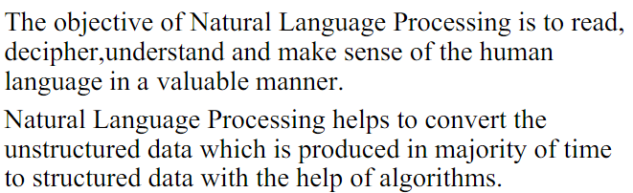
Objective

Slide 22
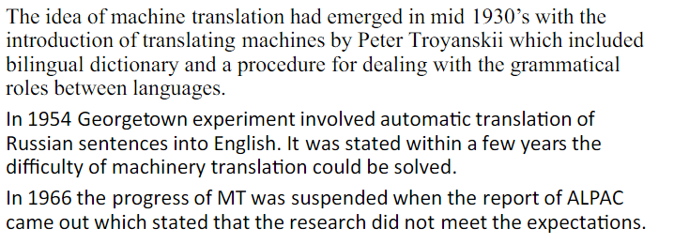
History of NLP

Slide 23
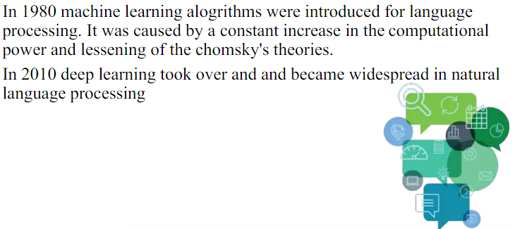
History of NLP Conti.

Slide 24
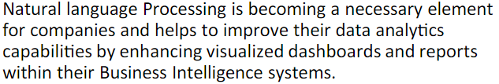
NLP as a Disruptive Technology

Slide 25
Components of NLP
1
Input
2
Speech Recognition
3
NL Understanding
Components
4
NL Generation
5
Output

Slide 26
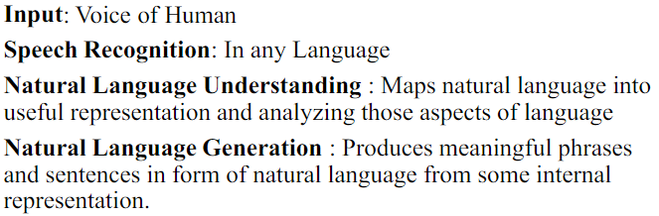
Components Conti.
NLP Components are as follows are:
Wholly Derived
Process

Slide 27
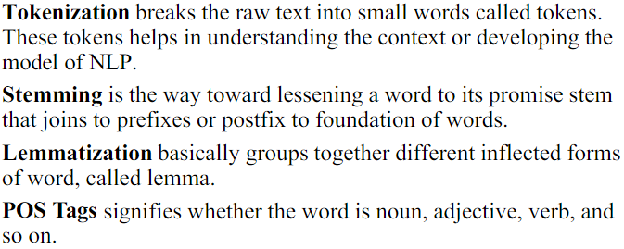
NLP Working
Wholly Derived
Process

Slide 28
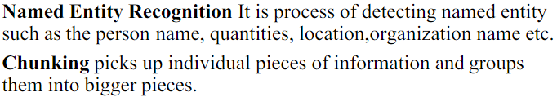
NLP Working Conti.
Wholly Derived
Process

Slide 29
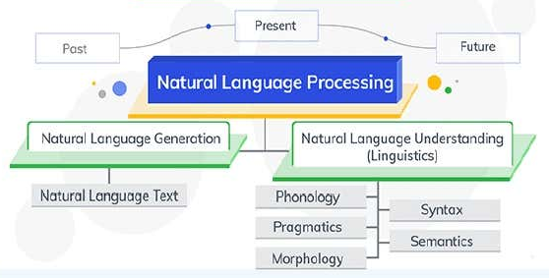
Evolution of NLP
Methods
Survey Methodology

Slide 30
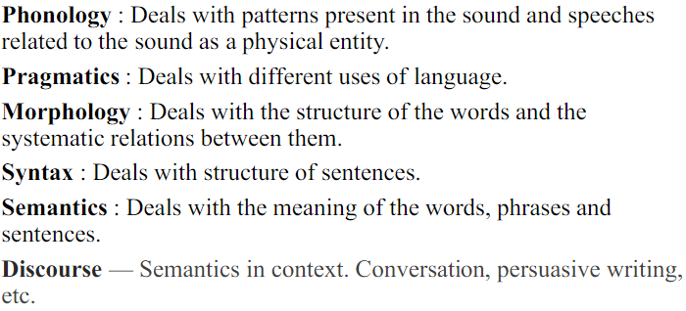
Evolution Conti.
Wholly Derived

Slide 31
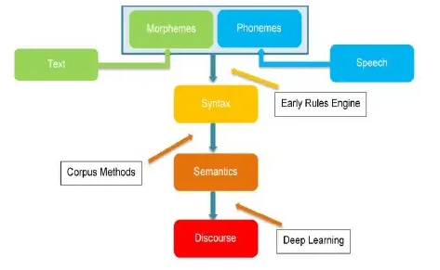
Evolution Conti.
Wholly Derived

Slide 32
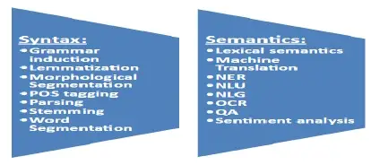
Applications of NLP
Syntax and Semantics
Discourse &
Speech

Slide 33
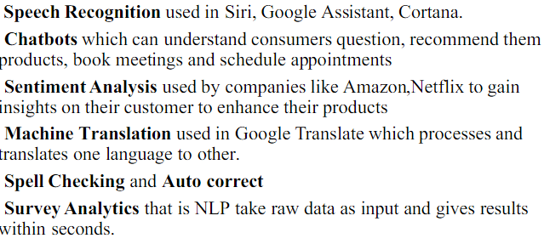
Applications of NLP Conti.

Slide 34
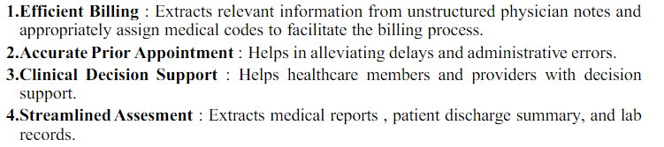
NLP in Health Care Sector
Healthcare

Slide 35
Future Trends
NLP

